Slide 1


Slide 2
 | Country | Home | Personal
Graph
Data
Scenario
1
2
3
4
5
6
7
8
9

Slide 3
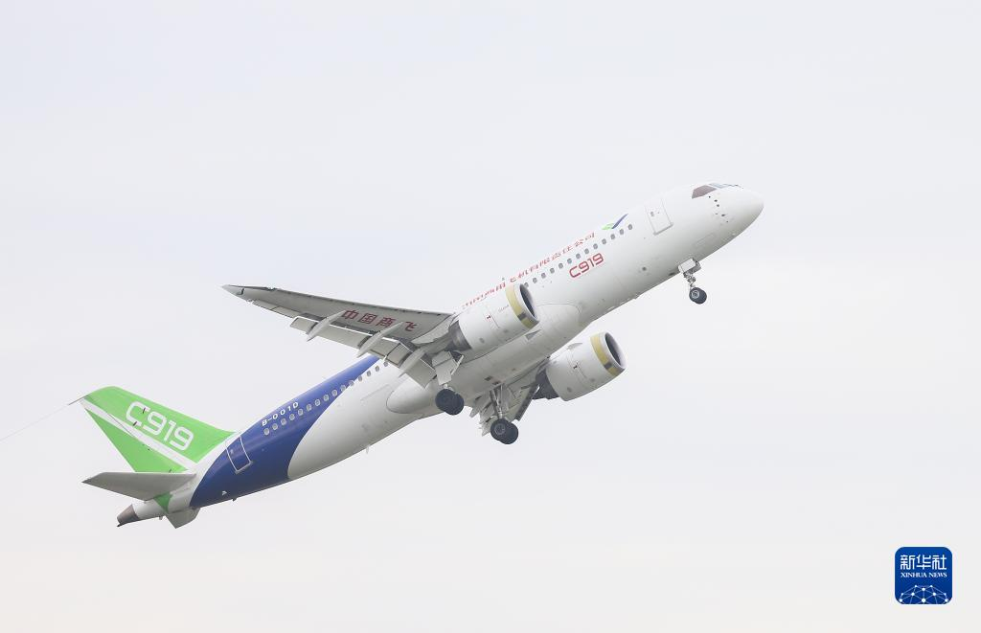
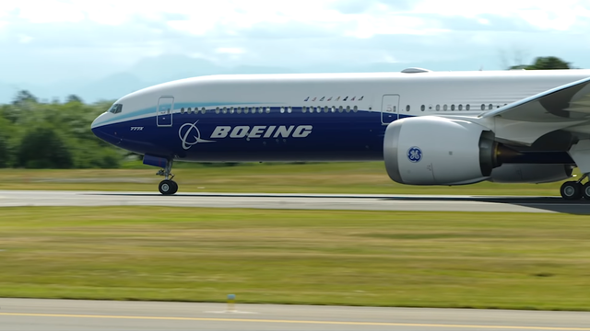
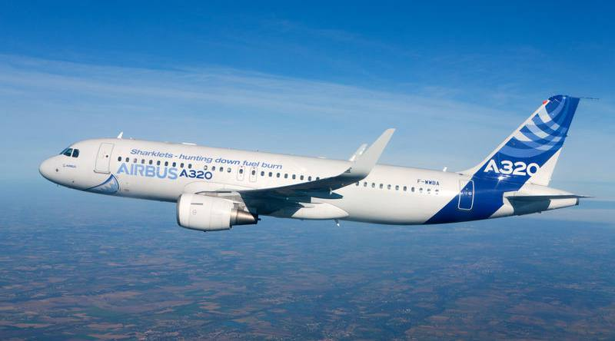
Graph + Country
Impromptu speech
China C919
Boeing 737
Airbus A320

Slide 4

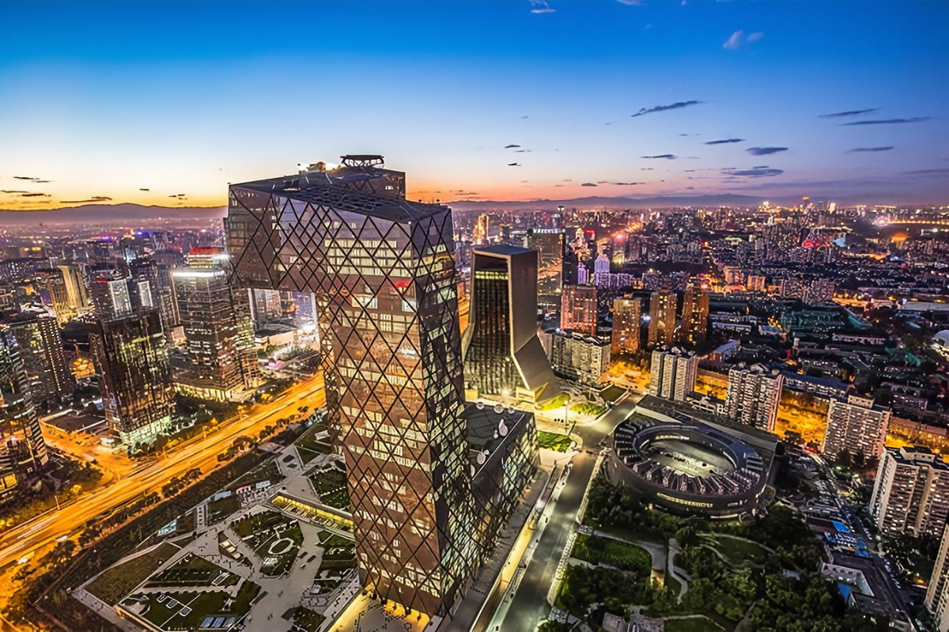
Graph + Home
Impromptu speech
Rural
Urban

Slide 5


Graph + Personal
Impromptu speech
10y ago: Free time
Now: Free time

Slide 6
Data
Data + Country
GDP: 50 trillion in 2012, 100+ trillion in 2022
Jobs: Averagely 10 million new urban jobs were created each year
Question
Analysis its challenge

Slide 7
Data
Data + Home
100+ million rural residents were lifted out of poverty
800+ poor counties take off their hats
Question
Image Role => Talk Rural Change

Slide 8
Data
Data + Personal
1 billion Internet users 2022
Question
Make friends easier or hardier?
Learning easier or harder?

Slide 9
Scenario + Country
Scenario
Imagination about future 10 years.

Slide 10
Scenario + Home
Scenario
If you were the head of a county, will you follow the step or leave the step of previous one to develop your hometown?

Slide 11
Scenario + Personal
Scenario
What biggest opportunity you missed in past 10 years?
How will you grasp it if had it again?

